Slide 1

Note: The data and information in this document is reflective of a hypothetical situation and client. This document is to be used for KPMG Virtual Internship purposes only.
Sprocket Central Pty Ltd
Data analytics approach
[Division Name] - [Engagement Manager], [Senior Consultant], [Junior Consultant]

Slide 2
Note: The data and information in this document is reflective of a hypothetical situation and client. This document is to be used for KPMG Virtual Internship purposes only.
Agenda
Introduction
Data Exploration
Model Development
Interpretation

Slide 3
Note: The data and information in this document is reflective of a hypothetical situation and client. This document is to be used for KPMG Virtual Internship purposes only.
Introduction
Developing a strategy to boost business using Data Analytical tools.
The motive of the analysis is to find the traits of the customers with high average profit and use those traits to filter out target customers from the New_Customer data set.
Process Followed :
Following changes were made to the given data sets before performing analysis:
Join(Inner) the three datasets on the customer_id column.
Drop rows containing missing values.
Drop irrelevant columns like first_name, last_name etc.
Create new categorical variable- “Life-Stage” :Signifying the life stage of the customer(Teen, Young, Man, Retired) depending upon their age.
Create new categorical variable- “Experience” :Signifying the Experience of the customer(Fresher, Junior, Senior, Experienced) depending upon their tenure at their current job.
Create a new quantitative variable “Profit” : Signifying the profit earned by the company on each transaction.

Slide 4
Note: The data and information in this document is reflective of a hypothetical situation and client. This document is to be used for KPMG Virtual Internship purposes only.
Data Exploration
Profit is considered as the dependent variable for our analysis.
As a part of data exploration, the data was analysed by applying various filters to identify the traits of high-profit customers.
After extensive market and statistical analysis following were the key parameters identified in the customer data that would be critical to derive a strategy to boost business for the Client,
Job_Industry category,
wealth segment and
owning a car.
The data was filtered as per the Job_Industry_category and wealth segment of the customer and whether the customer owns a car and the average profit from each of the customers was observed.
The graph after applying the above filters can be observed by clicking on the following link.
After observing the graph, all the traits that had average profit greater than 585 were selected.

Slide 5
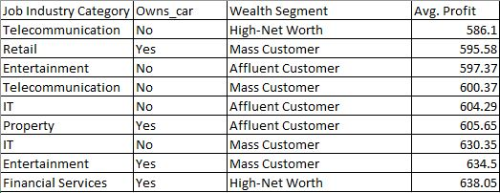
Note: The data and information in this document is reflective of a hypothetical situation and client. This document is to be used for KPMG Virtual Internship purposes only.
Model Development
After applying several filters, the company made average profit greater than 585 for customers of the following traits:
The given dataset tells us that targeting new customers having the above traits would be beneficial for the company.

Slide 6
Note: The data and information in this document is reflective of a hypothetical situation and client. This document is to be used for KPMG Virtual Internship purposes only.
Interpretation
The traits filtered from the previous analysis have been applied to the new_customer data set in this section.
After performing data wrangling, the dataset had 818 rows.
After applying the filters to the dataset, 94 customers were shortlisted.
Targeting these customers would be more profitable for the company.
To view the details of these customers click here.

Slide 7
Note: The data and information in this document is reflective of a hypothetical situation and client. This document is to be used for KPMG Virtual Internship purposes only.
Recommendation
After performing extensive data analysis to the given data sets, following recommendations can be made to the client:
Client should target customers of the following demographic attributes:
From the given list of 818 new customers, the company should specifically target 94 customers to maximize profit. The details of these customers can be found in the following link:New_Customers.

